Slide 1
thyssenkrupp Steering Changzhou
November 18, 2020

Slide 2
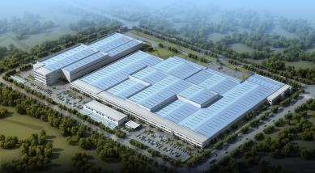






Company profile
General Information:
100% wholly owned
Production unit for ColPas, R-EPS, Dual Pinion and Cold Forging
SOP EPS in January 2016 (SOP Lines and Team in 2014 at TK-PS)
SOP Cold Forging in December 2017
Projects:
R-EPS : Daimler MRA C-Class (China and US) and E-Class (China)
Dual-Pinion EPS : Volvo Geely (CMA)
Colpas Servo Unit: SGMW (GP50), FAW (A-Platform and R020) and BAIC (C51E and B020)
Colpas System : Renault-Nissan CMFB-CMFCD, Ford C2, GAC, Geely
Cold Forging : Output Shaft and Yoke (internal) and GKN Trispher
Key Information new plant in China:
Name: thyssenkrupp Steering Changzhou (PCHZ)
Production: 40’000m² (Phase 1 EPS + Phase 1 CF)
Total Site: 120’000m²
Products:
R-EPS
Dual-Pinion EPS
ColPas System
ColPas Servo unit
Cold Forging
EPS Technologies and Cold Forging based in one location

Slide 3
thyssenkrupp Steering Changzhou - Timeline
2014 Dec
2015 Jan
Feb
Mar
Apr
May
Jun
Jul
Aug
Sept
Oct
Nov
Dec
Site
Selection
EPS
Investment
Agreement
Construction
Permit EPS
Movement
First
Lines
2015 Dec
2016 Jan
Feb
Mar
Apr
May
Jun
Jul
Aug
Sept
Oct
Nov
Dec
Movement
First
Lines
CF
Investment
Agreement
Construction
Permit CF
SOP Servo Unit
SGM , FAW, BAIC
SOP Servo Unit
FAW, BAIC
SOP R-EPS
MRA 205
SOP R-EPS
MRA 213
2016 Dec
2017 Jan
Feb
Mar
Apr
May
Jun
Jul
Aug
Sept
Oct
Nov
Dec
Move in Equipment CF
SOP Colpas RSA CMFB, GAC
SOP DP-EPS
CMA Volvo-Geely
SOP CF

Slide 4
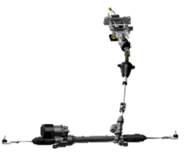
Technology Portfolio at thyssenkrupp Steering Changzhou from Sub-Components to Wheel-to-Wheel Solution
Cold Forging Components
Yokes & Shafts
Tripod & Trispher
Inner Races
Bevel Gears
Rack EPAS System
Column EPAS System
Rack EPAS Gear
Dual-Pinion EPAS Gear
Mid Torque Column EPAS
High Torque Column EPAS

Slide 5















Long-term Relationship with Leading OEMs Worldwide
Serving a diverse customer portfolio
Today Customers (current and booked projects)
Future possible new Customers

Slide 6








Projects Highlights
SOP Project Overview
Rack EPAS
DP EPAS
Column EPAS
 | Model | Annual Volume | 2011 | 2012 | 2013 | 2014 | 2015 | 2016 | 2017 | 2018 | 2019
 | FAW A-Platform
 | FAW R020
 | SGMW GP50
 | BAIC C51E/C32B/B20
 | Renault/Nissan CMF-B
 | GAC GS3, GS4, GA6
 | Ford C2B2
 | Renault CMF-C/D
 | DAI E-Class
 | DAI C-Class
 | Geely Volvo CMA
04/2016
06/2014
03/2017

Slide 7




















Depth of Added Value – Inhouse Manufacturiung
PCHZ Footprint
Colpas
Sen. Shaft
Gearbox
Powerpack
Column
Worm Wh.
Final Ass.
Input Sh.
Output Sh.
Sensor
MSG
MoB
Driveline
Steering Y.
Shaft.
Gear
MoB
MoB
WW
Rack
Shaft
Pinion
Cold Forging
Ball Screw
IS
PP
FA
Dual Pinion and Rack-EPS
MoB
Make or Buy decisions ongoing
Focus: Market related inhouse manufacturing

Slide 8



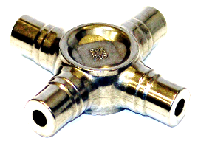




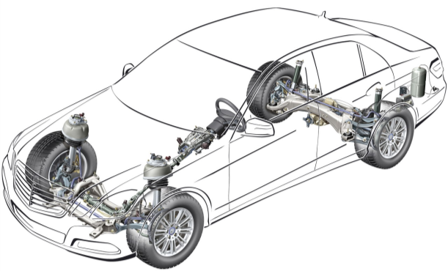
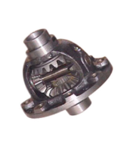
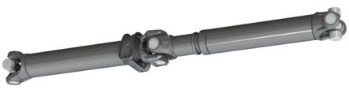





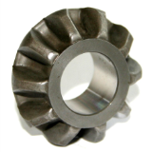
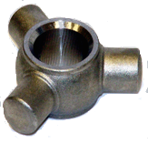
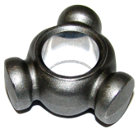
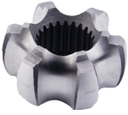
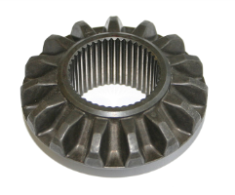
thyssenkrupp Presta Cold Forging:
Supplying OEM’s through our Customers / Driveline Segment
Spiders: 15 Mio. pieces per year
Tripodes / Trispheres / Inner races:
40 Mio. pieces per yr.
Bevel Gears 3.5 Mio. pieces per year
engineering. tomorrow. together.

Slide 9
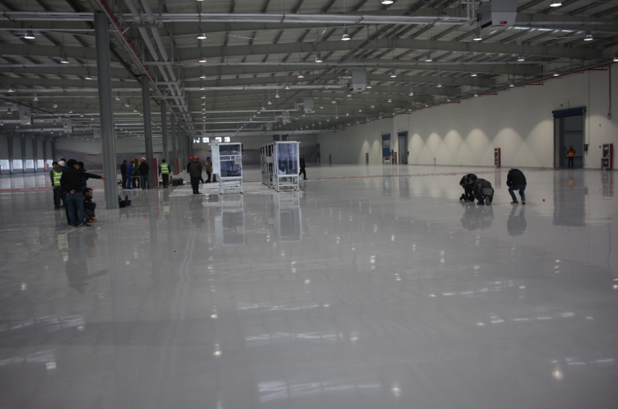
Today to Tomorrow
engineering. tomorrow. together.

Slide 10
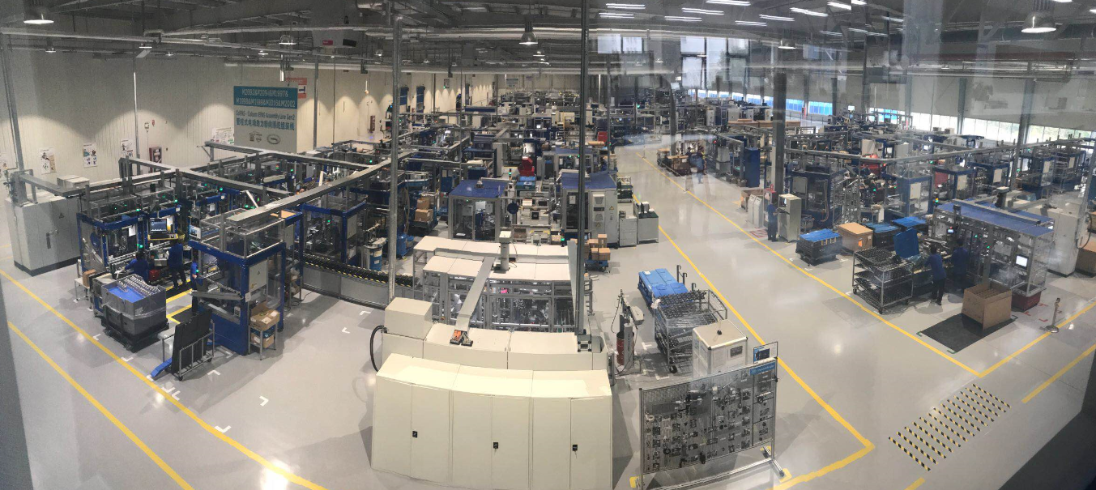
Today to Tomorrow
engineering. tomorrow. together.

Slide 11
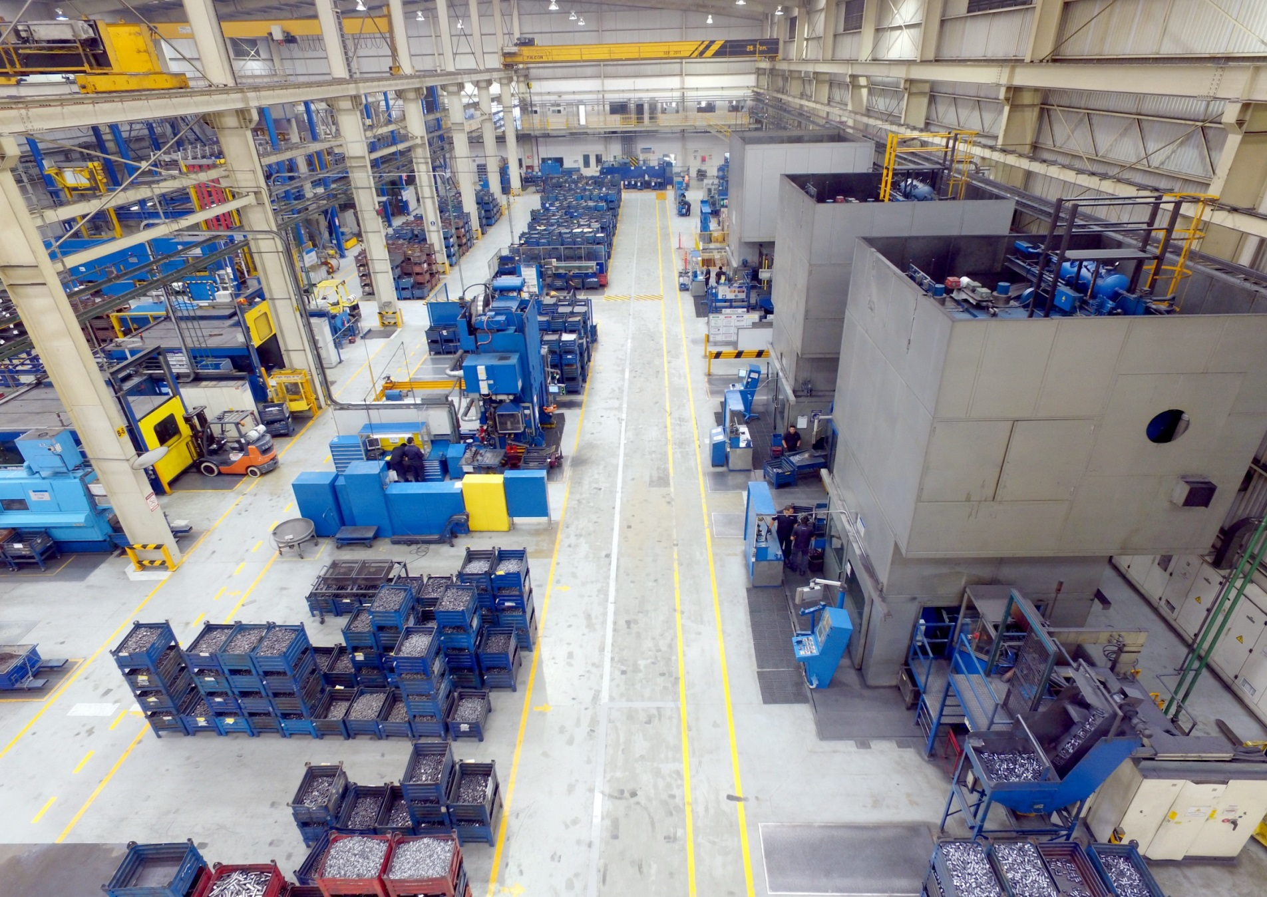
Today to Tomorrow
engineering. tomorrow. together.

Slide 12
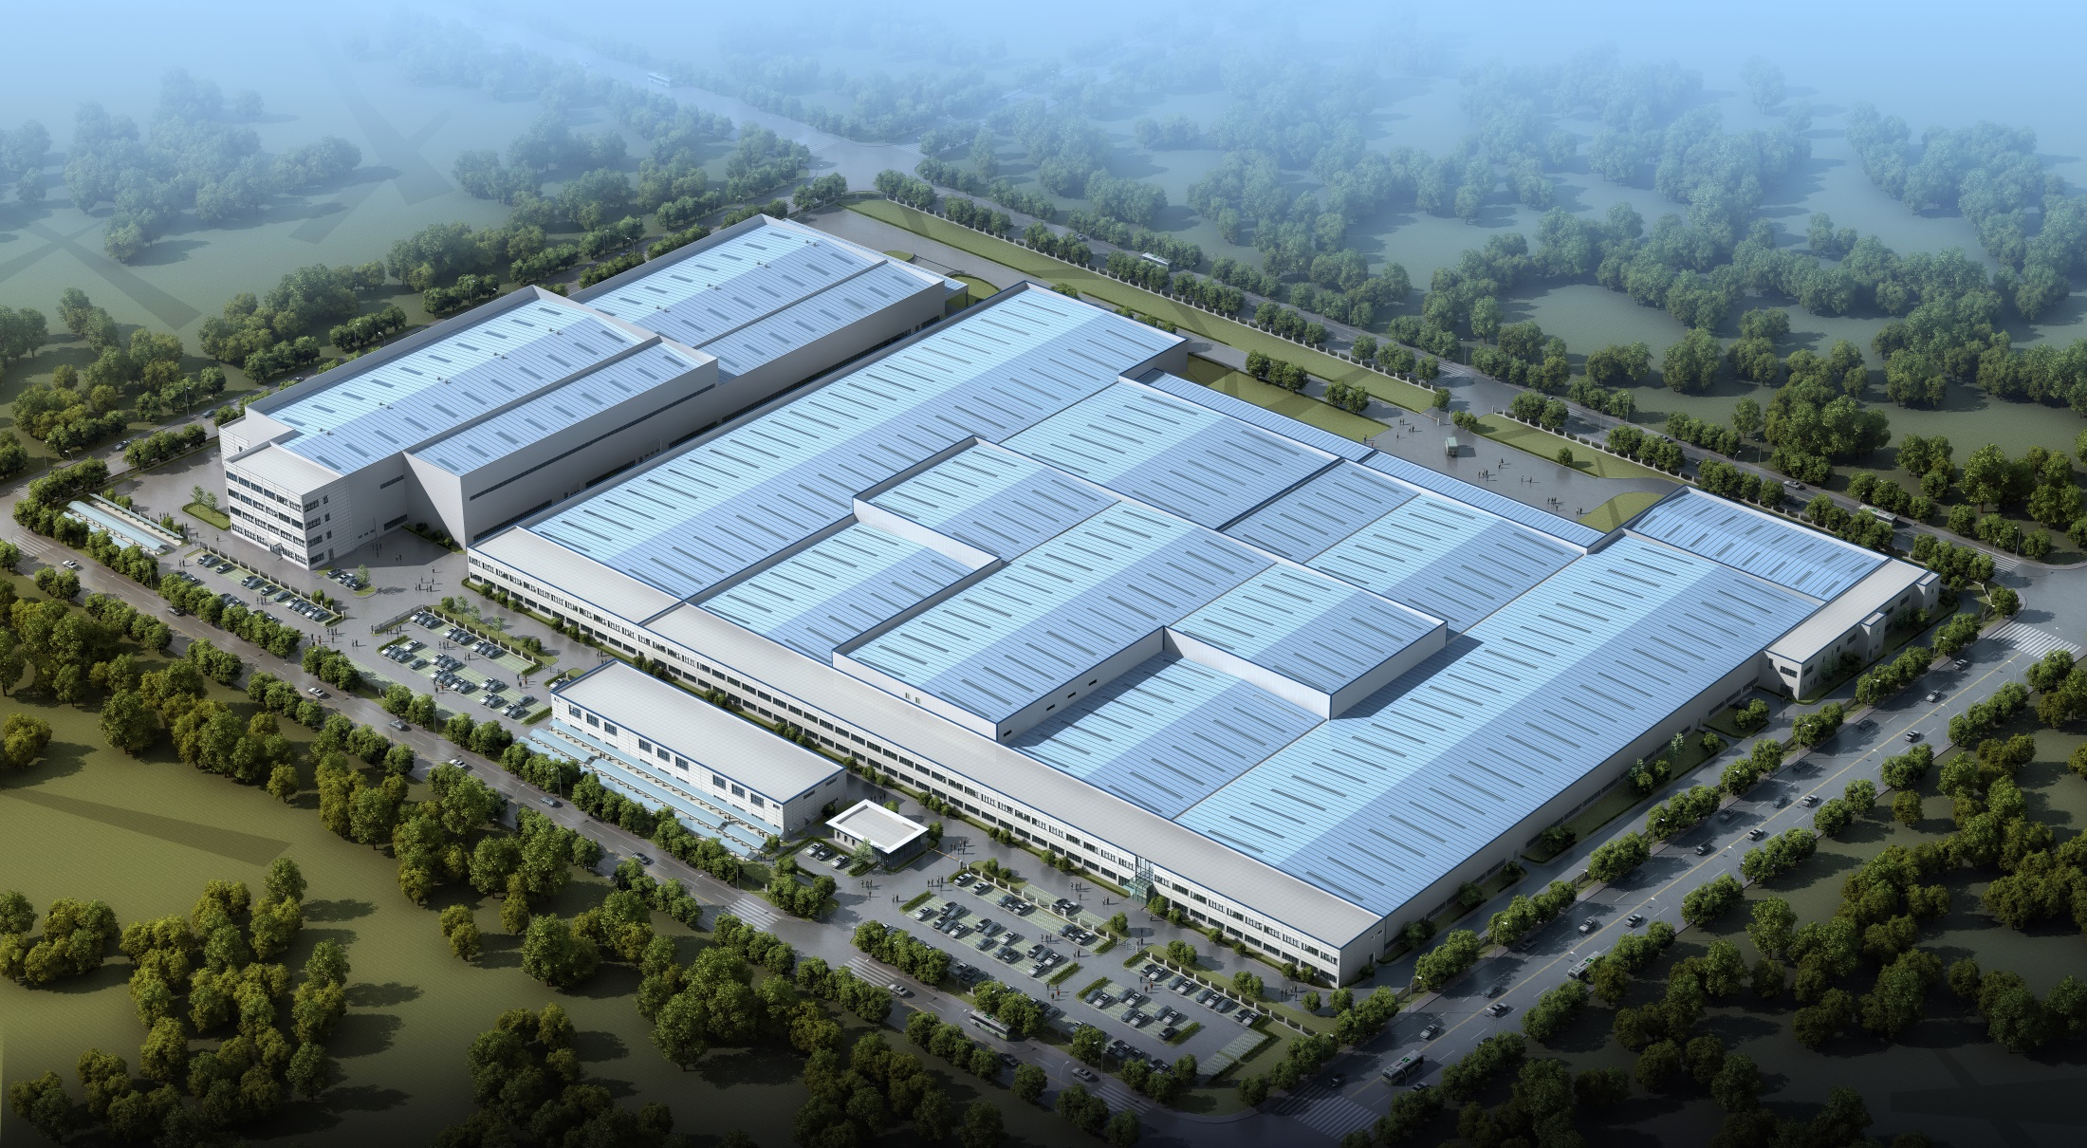
Extension Phase TK-PCHZ
Phase 1
CF
New Phase
New Phase
Phase 3
EPS
Phase 2
EPS
Phase 1
EPS
...currently on time

Slide 13
Agenda
Hot Positions

Slide 14
PCHZ Hot Positions and Requirements_Intern
Positions
Requirements:
1.HR Intern 人力资源实习生
Main responsibility
1.deal with new hires, employee information input;
2.auxiliary attendance management;
3. help foreign personnel related issues;
4. visitors reception;
5. WeChat platform maintenance and periodical publishing company
1. Full-time university bachelor or master degree graduates in 2021, intern at least 3-4 days a week
2. Good English speaking, reading and writing
3. Able to skillfully use Word, Excel, PowerPoint and other office software
4. Good communication skills, interpersonal skills and ability to solve problems
5. Have good team spirit, willing to share
6. Self-motivation, the good faith integrity, character, cheerful, easy to get along with
2.Production Planner生产实习生
Main responsibility
1. tracking consignement stock
2. tracking change management execution
3. tracking the record from shopfloor
3.Finance Intern 财务实习生
Main responsibility
1. Sort out the voucher monthly
2. Submit some files to tax bureau
3. Submit some document to bank
4. Support some accounts payable work ,
including sort out invoice , copy for payment .
5. Verify VAT invoice and prepare list
6. Assist accountant to check VAT invoice balance
7. Customs basic information record in tax system
8. Support to issue VAT invoice to customer

Slide 15
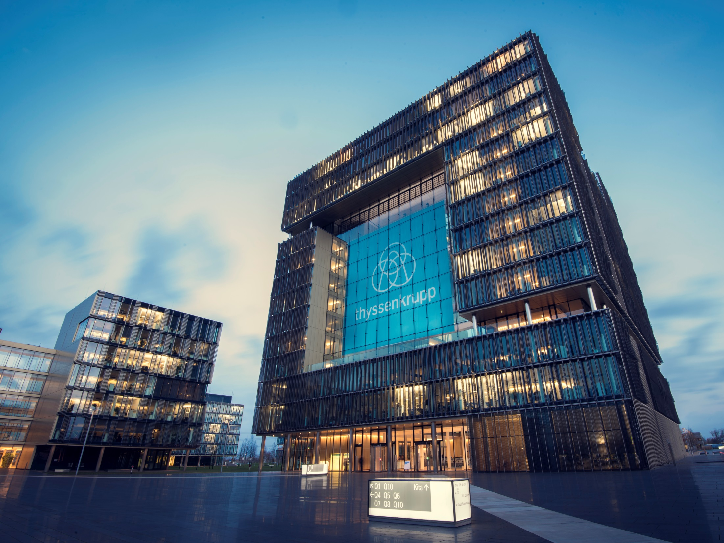
Thank You
Vielen Dank
谢 谢

